Slide 1
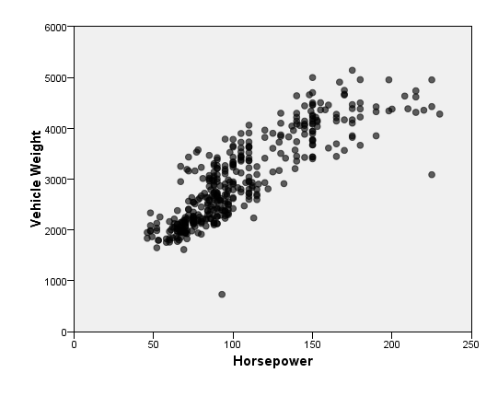
Getting started with regression techniques in SPSS
Jarlath Quinn

Slide 2
Just waiting for all attendees to join…
Getting started with regression techniques in SPSS
Jarlath Quinn

Slide 3
FAQ’s
Is this session being recorded? Yes
Can I get a copy of the slides? Yes, we’ll email links to download materials after the session has ended.
Can we arrange a re-run for colleagues? Yes, just ask us.
How can I ask questions? All lines are muted so please use the chat panel – if we run out of time we will follow up with you.

Slide 4
Premier accredited partner to IBM, Predictive Solutions and DataRobot specialising in advanced analytics & big data technologies
Work with open source technologies (R, Python, Spark etc.)
Team each has 15 to 30 years of experience working in the advanced and predictive analytics industry
Deep experience of applied advanced analytics applications across sectors
Retail
Gaming
Utilities
Insurance
Telecommunications
Media
FMCG
Notes:
We are an IBM partner – specialising in PA and SPSS
Staffed by…..

Slide 5
Agenda
Overview of regression techniques and linear relationships
Performing a Simple Linear Regression
Using Multiple Linear Regression to make predictions
Predicting response probability with Logistic Regression

Slide 6
What do we mean by ‘Regression’?
A family of statistical techniques used to predict outcomes and generate estimates for hundreds of applications
Linear Regression is used
when the outcome is continuous (or scale) data
the relationships between the fields can be described using straight lines
Quadratic Regression
Is a variant of Linear Regression when the outcome is continuous
the relationship with the dependent variable is curvilinear
Logistic Regression is used
When the outcome consists or 2 (or more) categories
Non-Linear regression
is commonly used when the target relates to growth or a power law

Slide 7
Where are Regression Techniques Used
Modelling the relationship between promotion spend and revenue
Estimating pollution levels following heavy rainfall
Predicting tourism revenue based on exchange rates and air travel costs
Predicting student test scores based on previous test results and peer-group performance
Estimating website hits based on re-tweets and follower numbers
Predicting sales of barbeques based on temperature forecasts

Slide 8
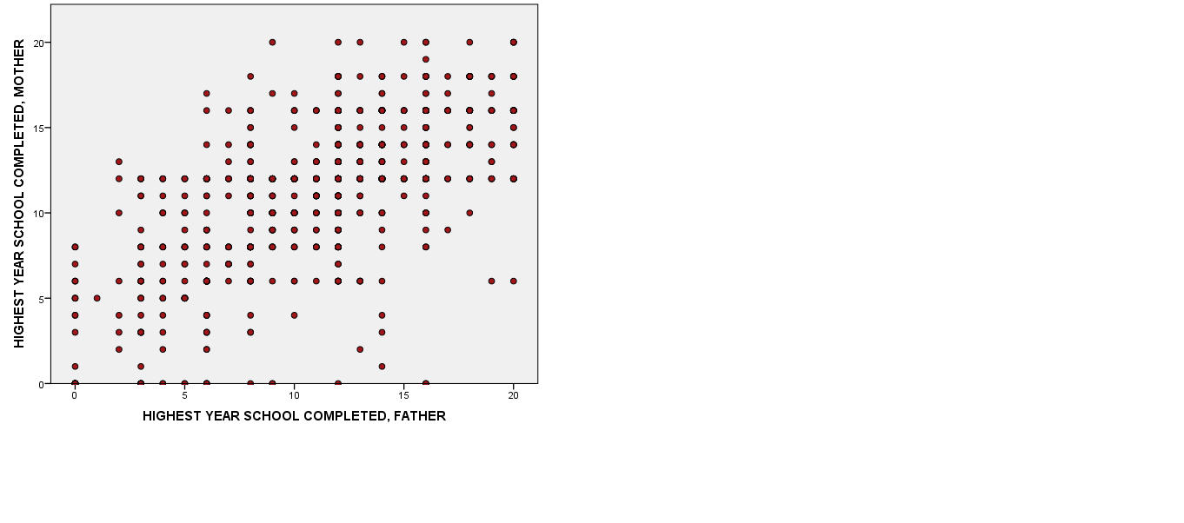
Regression to the Mean

Slide 9
Regression to the Mean
*jittered points

Slide 10
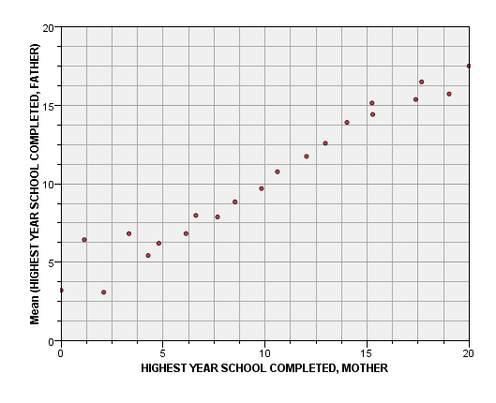
Regression to the Mean

Slide 11
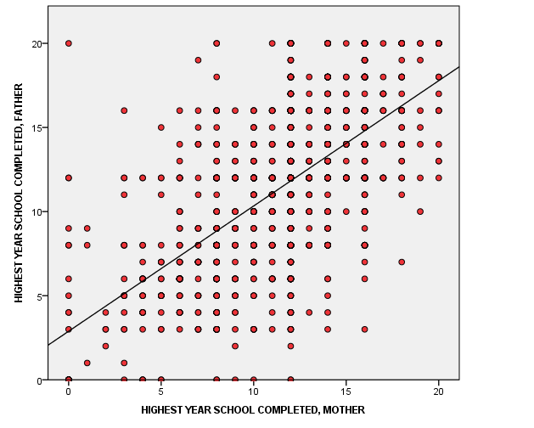
Regression to the Mean

Slide 12
Regression to the Mean
}
The regression line is drawn so it that minimises the differences between the points and line itself
( this is called the line of least squares)

Slide 13
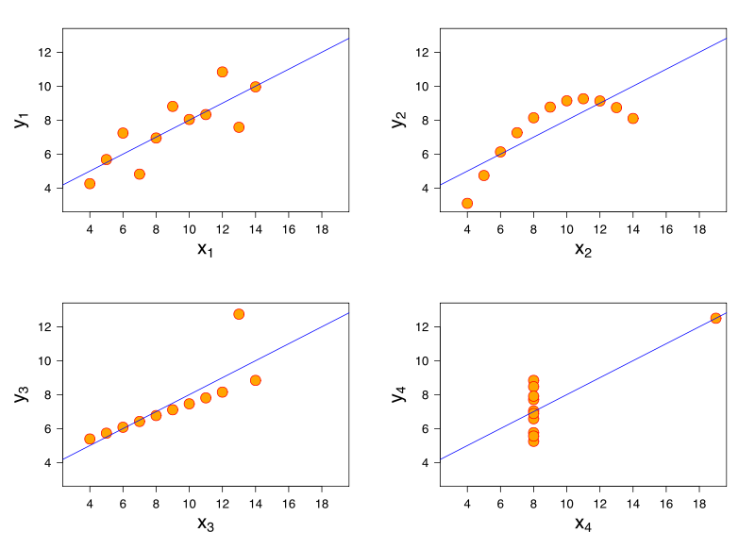
Regression to the Mean
*
But be careful…
It is just an average after all…
*Anscombe’s Quartet

Slide 14
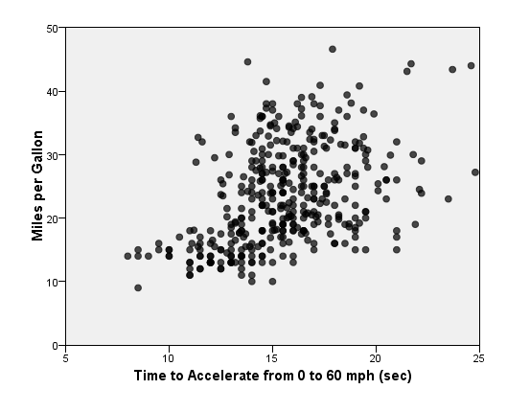
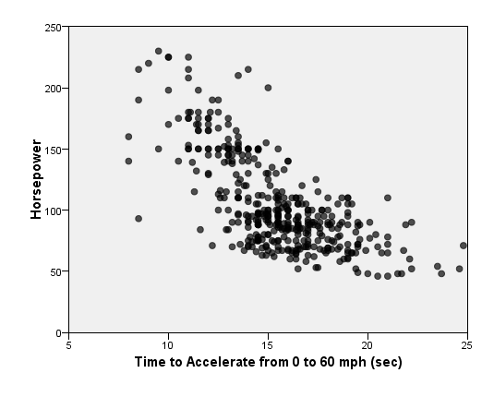
Measuring Linear Relationships
0.859
0.434
-.701
Pearson Correlation Values

Slide 15
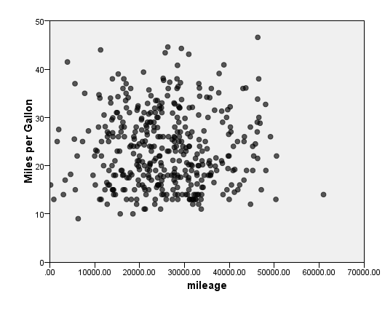
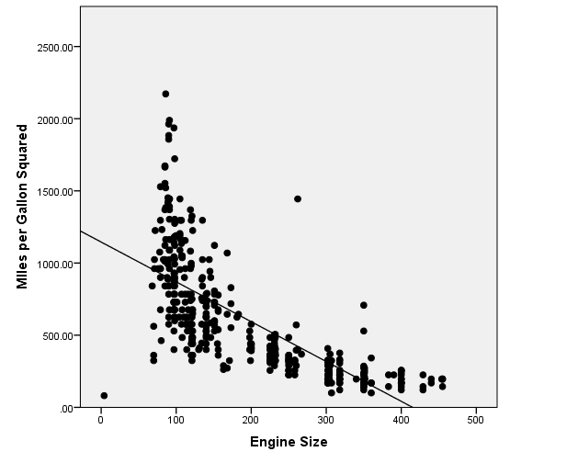
Non-Linear Relationships
-0.005
-.671
Pearson Correlation Values

Slide 16
Correlations as Percentages
Correlation = 0.859
0.859 x 0.859 = 0.738
0.738 = 73.8 %
Correlation Squared = ‘R Square’
73.8%

Slide 17
From Correlation to Prediction
How can we express linear relationships as predictive models?

Slide 18
How long does it take to cook a chicken?

Slide 19
How long does it take to cook a chicken?
7 minutes per pound plus 45 minutes
20 minutes per pound plus 20 minutes
y = mx + c
or
y = a + bx

Slide 20
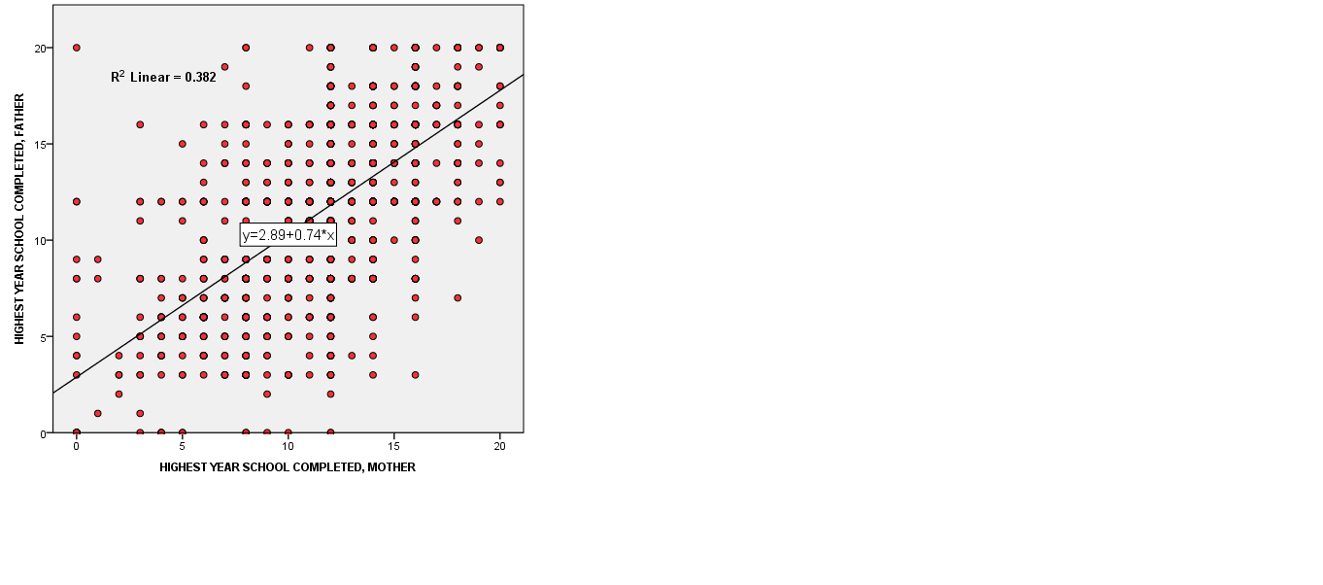
Notes:
2.89 + (10 *0.74) = 10.29

Slide 21
Lets look at a demo of Linear Regression in IBM SPSS Statistics

Slide 22
How can we predict category outcomes?

Slide 23
Logistic Regression
Allows us to predict things that linear regression can’t
Such as…
Response to a marketing campaign
Credit risk
Whether a subscriber is likely to renew a service
Risk of equipment failure
How likely is it that a particular patient will be readmitted to hospital
Whether a charity donor will switch to Direct Debit

Slide 24
Logistic Regression
But….
These outcomes are not continuous numbers so standard linear regression won’t work
When the outcome consists of two categories we use Binary Logistic Regression
When the outcome has three or more categories we use Multinomial Logistic Regression
Logistic gets around the limitations of describing relationships with straight lines by using a special sigmoid curve

Slide 25
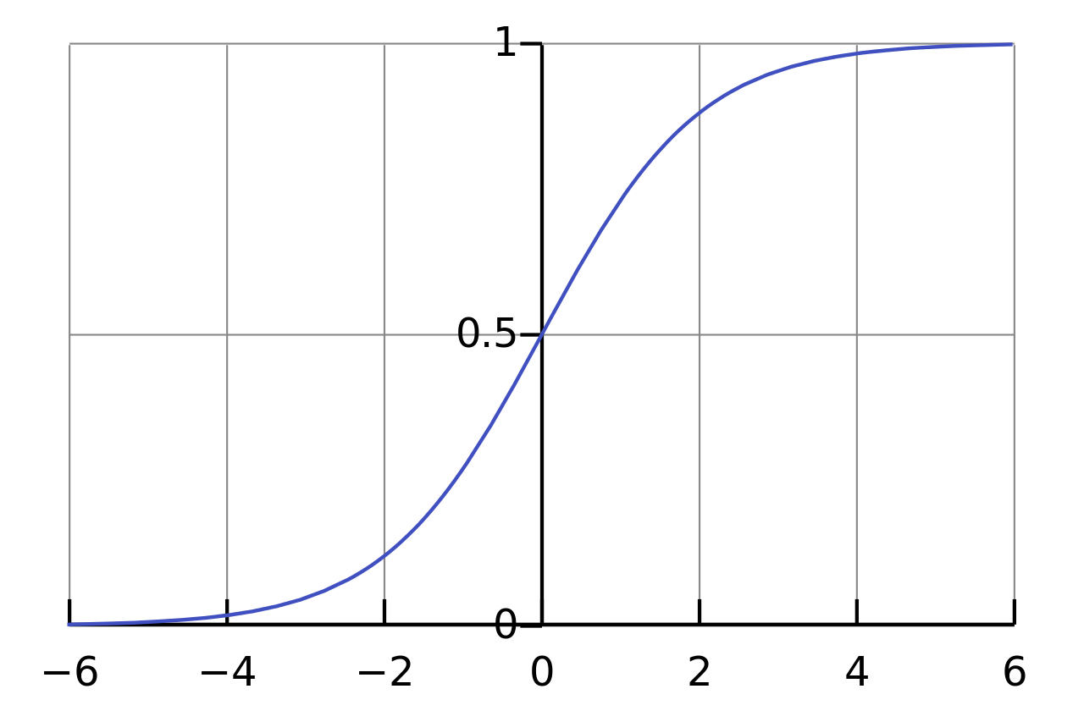
Logistic Regression
Probability of Responding
Discount %
00
Notes:
Our regression model will be predicting the logit, that is, the natural log of the odds of having made one or the other decision.
The number e is an important mathematical constant that is the base of the natural logarithm. It is approximately equal to 2.71828

Slide 26
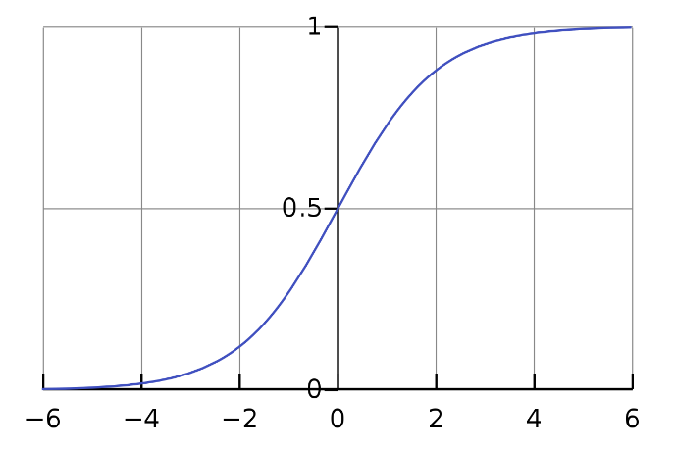
Logistic Regression
There is a special formula that converts the values of the predictor coefficients on the x axis to the values on predicted probabilities on the y-axis
But what are these numbers on the x-axis?
Probability
x

Slide 27
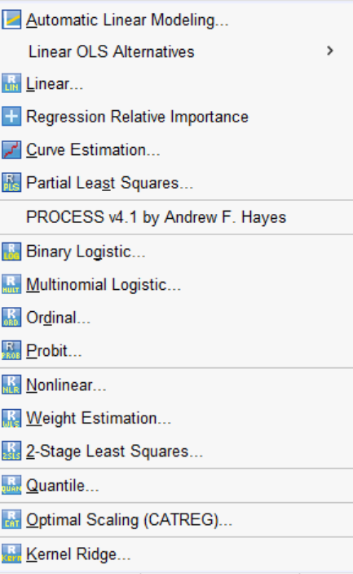
IBM SPSS Regression with R & Python integration
Using the SPSS Regression module, we can go beyond Linear Regression and unlock many other types of Regression functionality

Slide 28
Additional Resources
How to model non-linear relationships
Check what version / modules of SPSS you have installed
See exactly what is included in the Regression Module
Video Guides a wide range of SPSS “how to” topics with mini demos
Choosing the correct statistical test
How to interpret significance tests
Eat your greens blog series on statistical testing and procedures

Slide 29
Working with Smart Vision Europe Ltd.
Sourcing Software
You can buy your analytical software from us often with discounts
Assist with selection, pilot, implementation & support of analytical tools
http://www.sv-europe.com/buy-spss-online/
Training and Consulting Services
Guided consulting & training to develop in house skills
Delivery of classroom training courses / side by side training support
Identification & recruitment of analytical skills into your organisation
Advice and Support
offer ‘no strings attached’ technical and business advice relating to analytical activities
Technical support services

Slide 30
Contact us:
+44 (0)207 786 3568
info@sv-europe.com
Twitter: @sveurope
Follow us on Linked In
Sign up for our Newsletter
Thank you

