Slide 1
SPSS Statistics
Licence Options Explained
Felix Kraty – Customer Care
Rachel Clinton – Business Development

Slide 2
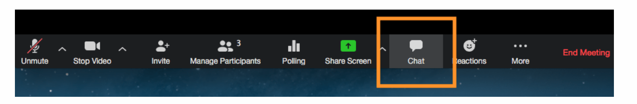
Housekeeping!
Is this session being recorded? Yes
Can I get a copy of the slides? Yes, we’ll email links to download materials after the session has ended.
Can we arrange a re-run for colleagues? Yes, just ask us.
How can I ask questions? All lines are muted so please use the chat panel – if we run out of time we will follow up with you.

Slide 3


Slide 4

SPSS Statistics Licences things to consider
What functionality is needed?
How many people need to use the software?
How long will it be needed for?

Slide 5
What functionality do you need?
SPSS Statistics is modular
  SPSS Base is the core component
  Various modules for extra functionality
Only the modules paid for can be accessed so it’s important to know what is needed

Slide 6

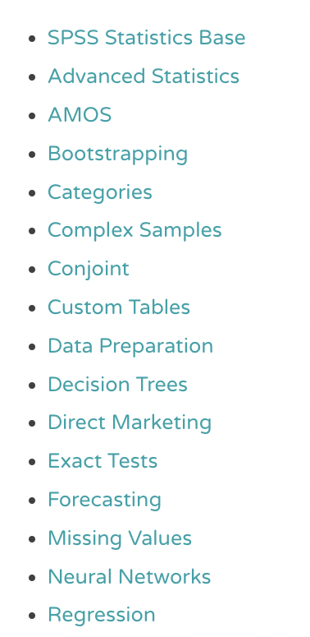
What functionality do you need?
Modules:
The smart vision website explains the functionality available in each module:
https://www.sv-europe.com/blog/what-is-in-each-spss-statistics-module/

Slide 7
Authorised v Concurrent Users
Authorised Licence
Concurrent Licence
Sometimes called: named or stand alone licence
1 Physical installation per licence
Sometimes called: server or network licence
Unlimited installations per licence.
Licence manager software controls how many people can access the software at a given time.

Slide 8
Authorised Licence example
Generally the cheaper licence option for 5 or fewer users
Each licence can be installed on one machine, so 2 authorised users can be installed on 2 different machines
Smart Vision can help you move your licences to new machines as needed (licence codes need to be unlocked)

Slide 9
Concurrent Licence example
Useful when you have many people needing SPSS:
  A team working across different timezones
  Many people who only need the software on an ad-hoc basis
Each licence can be installed on as many machines as you need:
  So 2 concurrent users can be installed an any number of machines
  A licence manager only allows 2 people to access the software at one time
  A 3rd person trying to log in will be asked to wait until a licence is free
Requires a server somewhere to install the licence manager application
This is the right licence type if you are running a virtual desktop / citrix

Slide 10

Licence Length or Term
Subscription Licence
Rent the software from us:
  On a monthly basis or for a set number of months
  Most often bought for 12 months at once as an annual subscription
Module options:
  Only set bundled options available for renting less than 12 months
  Full module flexibility with 12 month licence
Cheapest option for projects lasting 1 month – 3 years
The licence can be cancelled or renewed at the end of each term
Most suited to authorised user licences. Concurrent only available for 12 months +
Includes access to Smart Vision Telephone Technical Support & SPSS Statistics upgrades

Slide 11
Licence Length or Term
Perpetual Licence
Outright licence purchase
Cheapest option for long term use
Initial purchase includes 1st year Smart Vision Telephone Technical Support & SPSS Statistics upgrades
After 12 months, support & access to upgrades can be renewed (at approx 20% cost of purchase) or it can be cancelled. If cancelled you can continue using the version you have indefinitely.
Modules can be added individually at any time

Slide 12
Licence Length or Term
Subscription Licence
Perpetual Licence
Rent the software monthly
up to 12 months at a time
Cheapest option for projects lasting
between 1 month – 3 years
The licence can be cancelled at the
end of each term
Includes access to Smart Vision Telephone Technical Support & SPSS Statistics upgrades
Some module restrictions if purchasing for less than 12 months and tricky to add extra modules mid term
If buying a 12 month licence then modules can be added at any time
Outright licence purchase
Cheapest option for long term use
Initial purchase includes 12 months Smart Vision Telephone Technical Support & SPSS Statistics upgrades
After 12 months, support & access to upgrades can be renewed (at approx 20% cost of purchase) or it can be cancelled. If cancelled you can continue using the version you have indefinitely
Modules can be added individually at any time

Slide 13
SPSS Statistics Licences things to consider
What functionality is needed?
  Smart Vision website sets out module options
How many people need to use the software?
  To decide if you need an authorised or concurrent licence
How long will it be needed for?
  To decide between a subscription (rental) or perpetual (outright purchase) licence

Slide 14
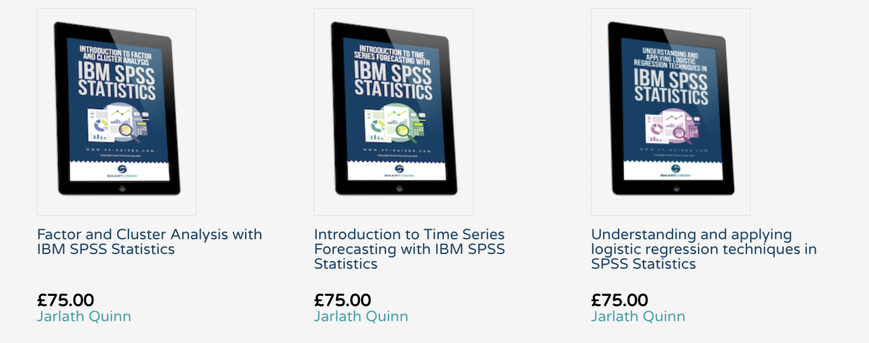
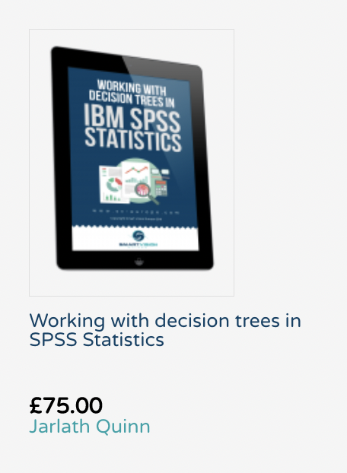
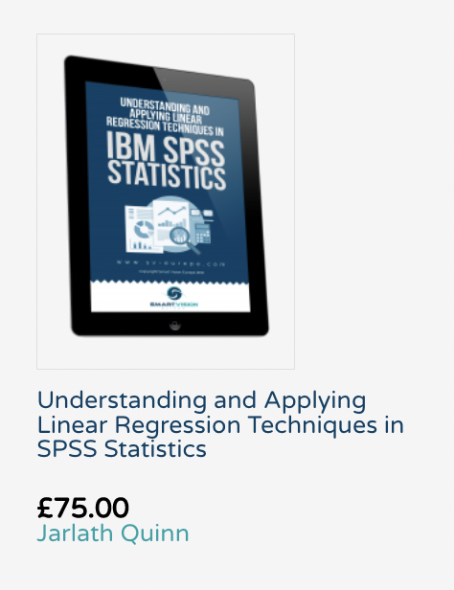
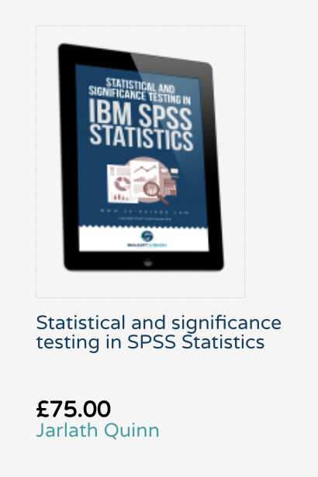
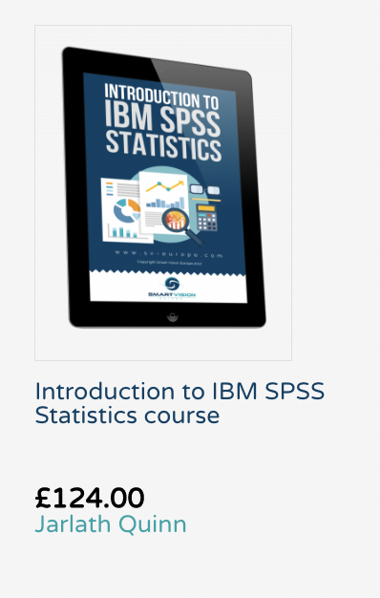
Free access to SPSS self-paced online training

Slide 15
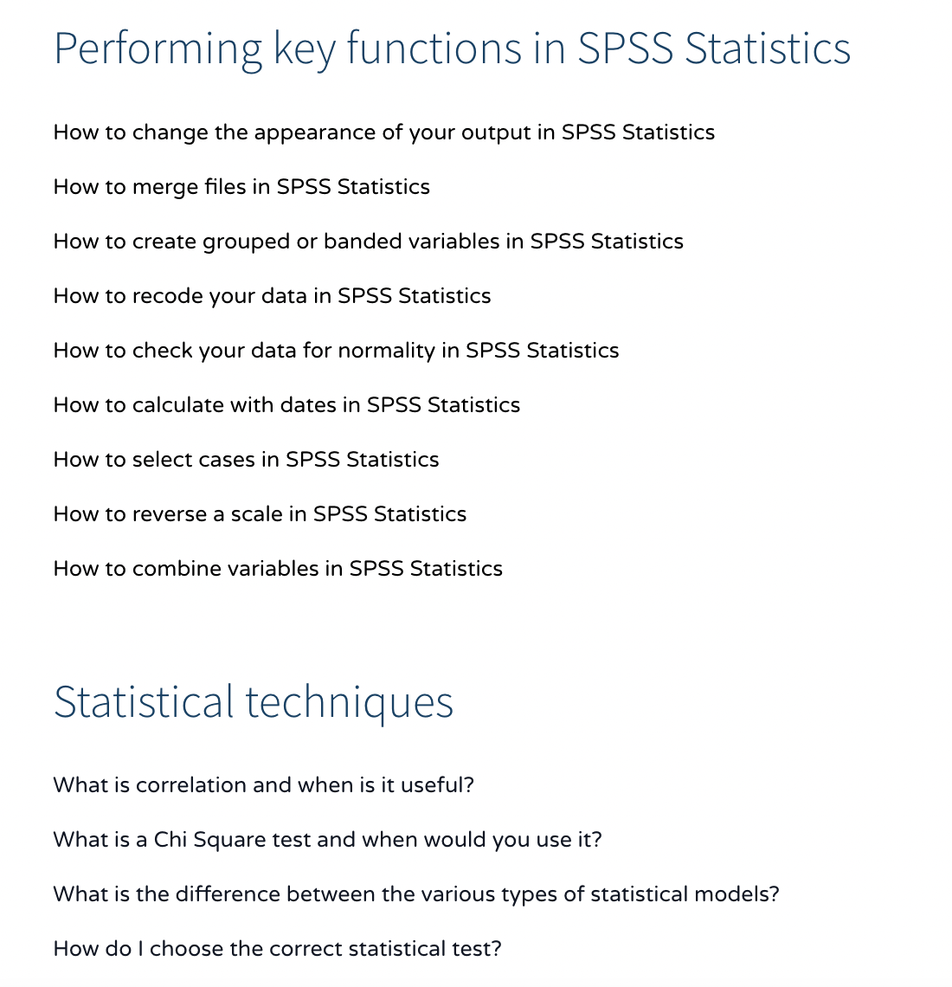
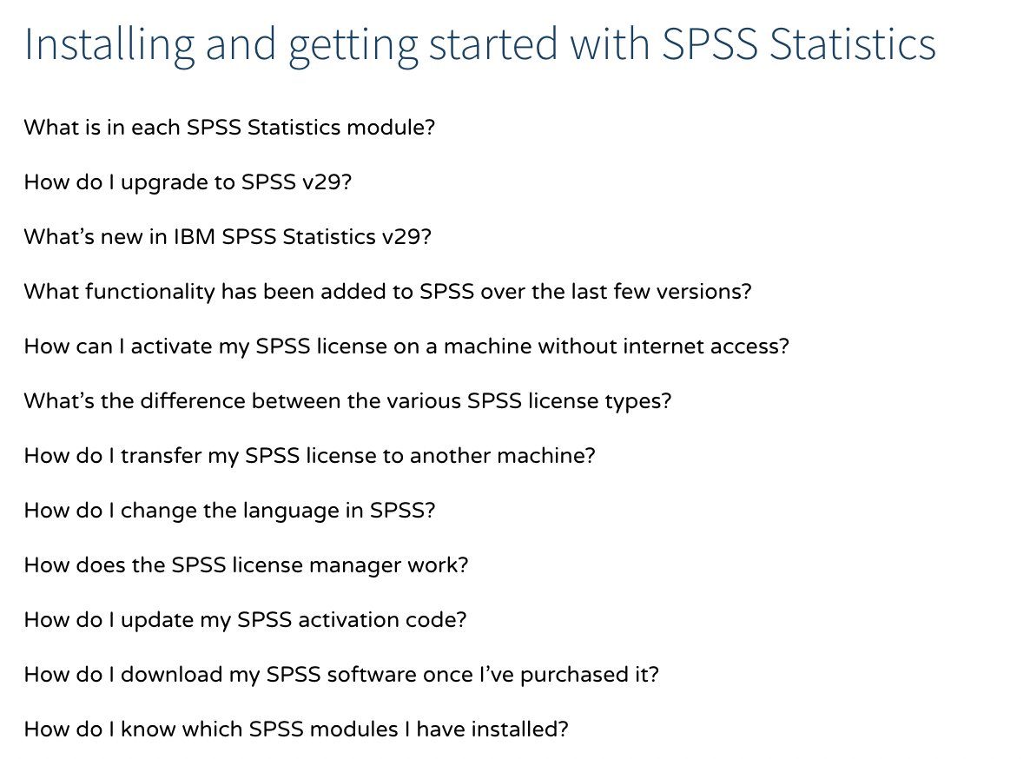
Free video content

Slide 16
Contact us:
+44 (0)207 786 3568
www.sv-europe.com
info@sv-europe.com
Thank you, any questions?

