Slide 1
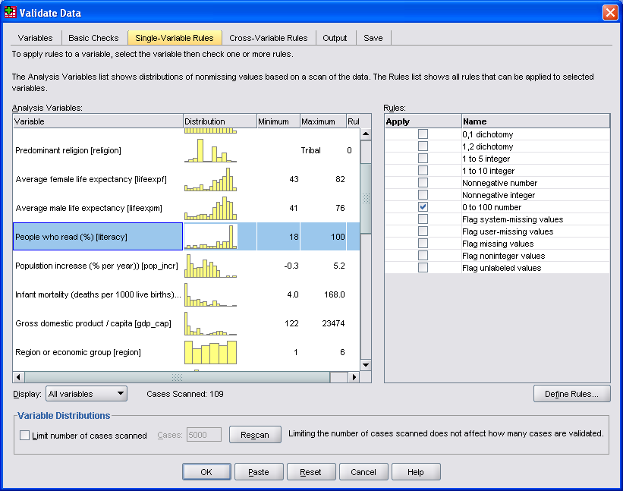
Data Cleaning with IBM SPSS Statistics
Jarlath Quinn – Analytics Consultant

Slide 2
Data Cleaning with IBM SPSS Statistics
Jarlath Quinn – Analytics Consultant
Just waiting for all attendees to join…

Slide 3
FAQ’s
Is this session being recorded? Yes
Can I get a copy of the slides? Yes, we’ll email links to download materials after the session has ended.
Can we arrange a re-run for colleagues? Yes, just ask us.
How can I ask questions? All lines are muted so please use the chat panel – if we run out of time we will follow up with you.

Slide 4
Premier accredited partner to IBM, Predictive Solutions and DataRobot specialising in advanced analytics & big data technologies
Work with open source technologies (R, Python, Spark etc.)
Team each has 15 to 30 years of experience working in the advanced and predictive analytics industry
Deep experience of applied advanced analytics applications across sectors
Retail
Gaming
Utilities
Insurance
Telecommunications
Media
FMCG
Notes:
We are an IBM partner – specialising in PA and SPSS
Staffed by…..

Slide 5
Errors and problems in data
Data cleaning is an almost universal problem for anyone who works with data
Errors and irrelevancies in data can occur due to:
Data input mistakes such as misplaced keystrokes
Inconsistencies in recording information between different data entry operators or due to changes over time
Information collected on non-applicable events or subjects
Mismatches between database tables
Differences in how various systems encode or represent data such as date/time fields

Slide 6
Challenges in data cleaning
Typical tasks include:
Identifying records/fields with a high percentage of missing values, a high degree of variability or conversely, too little variability
Correcting values that are out of range: e.g. people aged 199 or years employed with minus numbers
Identifying and removing duplicate records
Ensuring a variables are correctly formatted e.g. removing decimal places from age
Checking that the values in combinations of variables do not contradict each other or imply errors in the data: e.g. all car drivers should be at least 17 years old
Creating syntax to correct data issues automatically

Slide 7
Two broad classes of data errors
In SPSS, most issues with data fall into one of two categories:
Data formatting issues can be caused by how the data were stored in other systems
Problems with the data file itself can be caused by human error or systematic failures
Problems with how the data has been formatted/imported:
Date/time variables
Defining missing values
Variable/value labels
Variable types – strings vs numeric
Variable names
Problems with the data itself:
Actual errors
Irrelevant values/variables/records
Inconsistencies
Duplicates
Illogical relationships

Slide 8
Data formatting problems

Slide 9
Problems with the data itself

Slide 10
Data cleaning with syntax

Slide 11
Additional Resources
SPSS FAQs everything from finding out what you have installed to how to merge files or change the language
Video Guides a wide range of SPSS “how to” topics with mini demos
SPSS Software information on products, modules and pricing
Eat your greens blog series on statistical testing and procedures

Slide 12
Working with Smart Vision Europe Ltd.
Sourcing Software
You can buy your analytical software from us often with discounts
Assist with selection, pilot, implementation & support of analytical tools
http://www.sv-europe.com/buy-spss-online/
Training and Consulting Services
Guided consulting & training to develop in house skills
Delivery of classroom training courses / side by side training support
Identification & recruitment of analytical skills into your organisation
Advice and Support
offer ‘no strings attached’ technical and business advice relating to analytical activities
Technical support services

Slide 13
Contact us:
+44 (0)207 786 3568
info@sv-europe.com
Twitter: @sveurope
Follow us on Linked In
Thank you

