Slide 1
Analytics for surveys and customer feedback
Jarlath Quinn – Analytics Consultant
Rachel Clinton – Business Development

Slide 2
FAQ’s
Is this session being recorded? Yes
Can I get a copy of the slides? Yes, we’ll email a PDF copy to you after the session has ended.
Can we arrange a re-run for colleagues? Yes, just ask us.
How can I ask questions? All lines are muted so please use the chat facility – if we run out of time we will follow up with you.

Slide 3

Premium, accredited partner to IBM specialising in the SPSS Advanced Analytics suite.
Team each has 15 to 20 years of experience working in the predictive analytic space - specifically as senior members of the heritage SPSS team
Notes:
We are an IBM partner – specialising in PA and SPSS
Staffed by…..

Slide 4
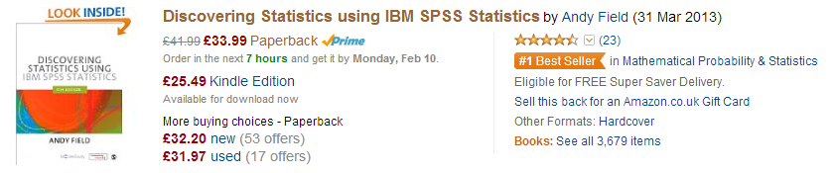
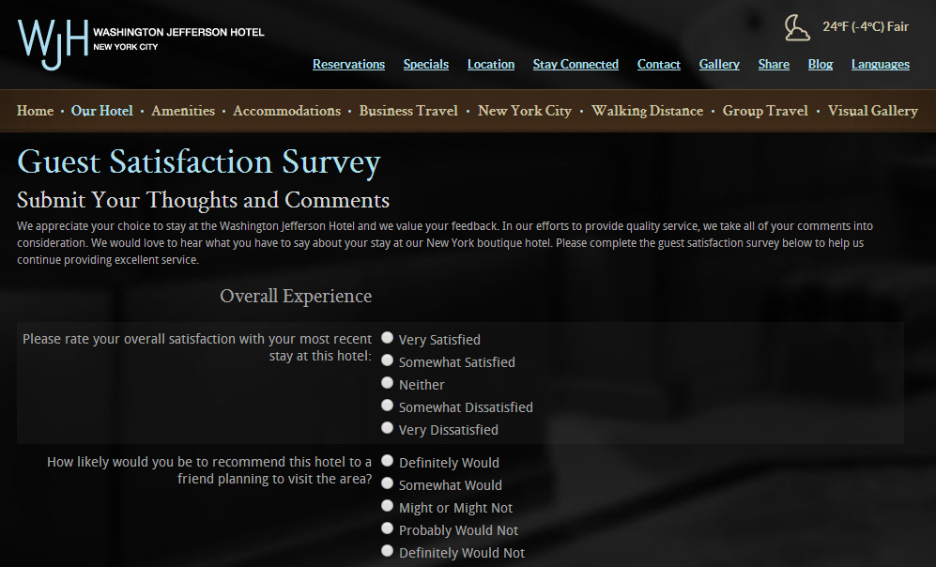
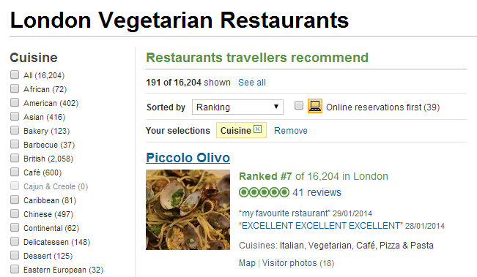
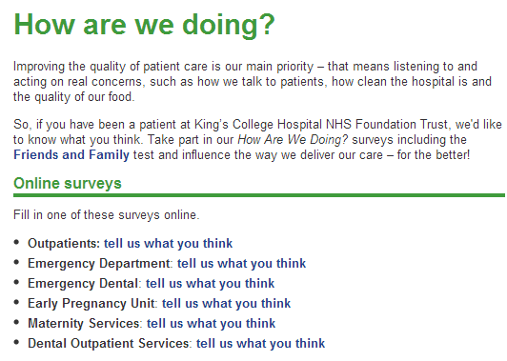
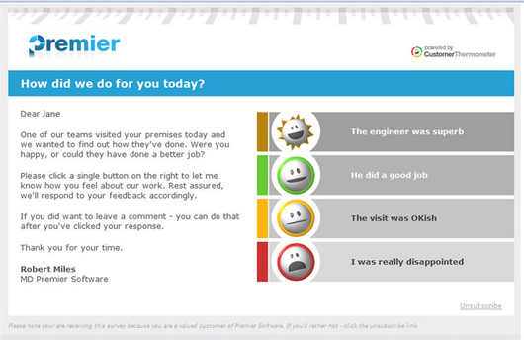
Surveys and feedback requests are everywhere

Slide 5
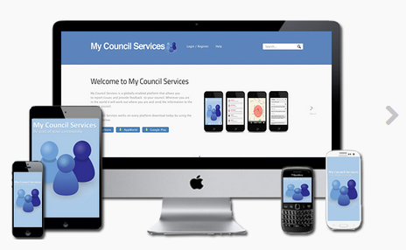
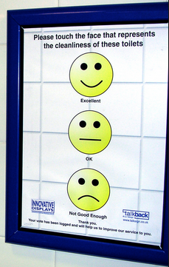
What drives the growth in surveys/feedback requests?
Cheap, Instant and automatic data collection
  Less need for human-powered data entry
  Even paper questionnaires can be easily scanned
Wide variety of collection channels
  Websites
  Social Media
  Apps
  Wall-mounted buttons
  Voice-to-text mechanisms
Huge variety of tools for design and analysis
  Statistical / Reporting / Visualisation software
  Online survey design/example templates

Slide 6


What drives the growth in surveys/feedback requests?
Customers and clients expect it
The biggest, fastest-growing global brands make a virtue of it
It generates valuable, even potentially critical, data
It adds an important dimension of customer/client insight
Exponential growth in unstructured data

Slide 7






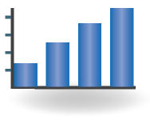


Feedback data forms a key component in strategic Predictive Analytics applications
Interaction
Attitudinal Data
Acquisition channel
Website visits,
Emails
Feedback/Surveys
Social Media
attract & acquire
grow value
risk
Descriptive
Transactional
Age, Education,
Gender, Postcode
Spend, Product Categories, Tenure, Card Type
retain

Slide 8
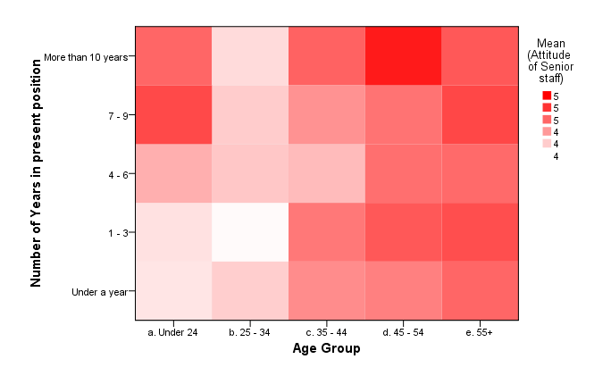
Uncovering Relationships

Slide 9
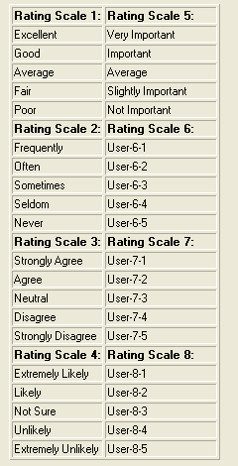
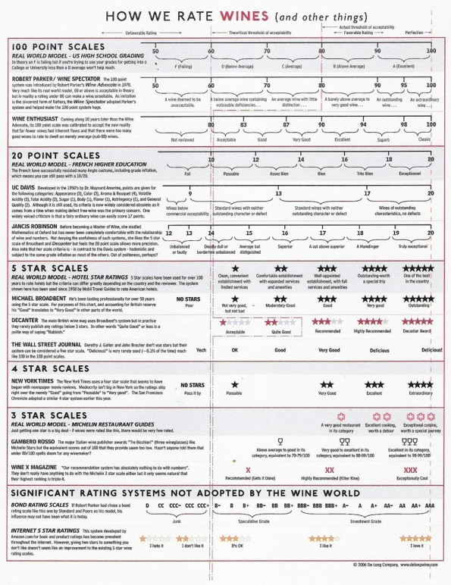
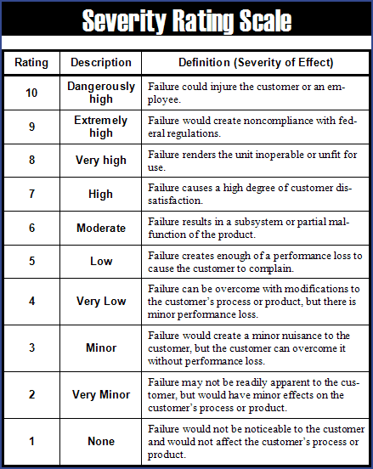
Working With Rating Scales

Slide 10
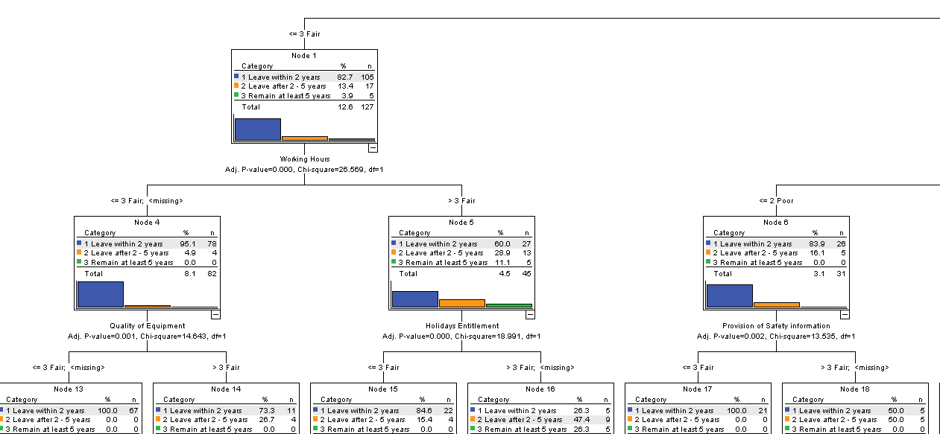
Satisfaction Prediction and Key Driver Analysis

Slide 11

Working with Longitudinal Survey Data
Putnam surveyed the decline of "social capital" in the United States of America since 1950.
Described this reduction in terms of the various the forms of social intercourse
Argued this undermines the active civil engagement which a strong democracy requires from its citizens.
Made the data available for download

Slide 12
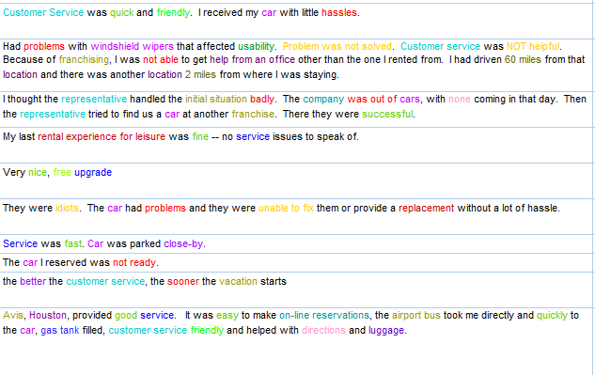
Analysing Open-Ended Text Responses

Slide 13
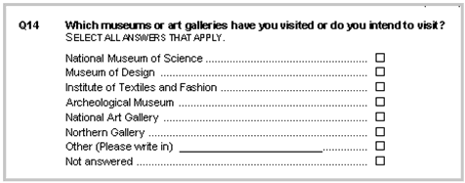
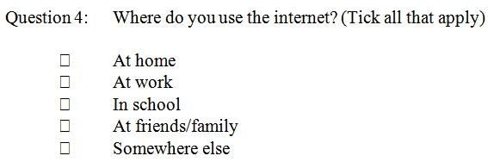
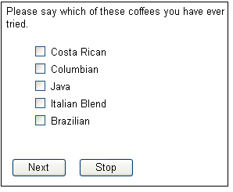
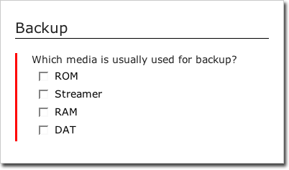
Working With Multiple Response Questions

Slide 14
Advice to get started
Focus on why the feedback/survey is being sought – what is it for?
Consider text analytics for open ended questions or feedback
Use SPSS Statistics syntax to automate the analysis process for regular reports
Highlight statistically significant relationships
Think about ways to combine rating scales
Consider if you could predict outcomes
Look for opportunities to combine survey/feedback data with other sources – this has been shown to be extremely powerful.

Slide 15
Working with Smart Vision Europe Ltd
As a premier partner we sell the IBM SPSS suite of software to you directly
  We’re agile, responsive and generally easier to deal with
As experts in SPSS / Analytics / Predictive Analytics we will
  deliver classroom training courses
  offer side by side training support
  offer “skills transfer” consulting
  run booster and refresher sessions to get more from your SPSS licences
  Give no strings attached advice
We are a support providing partner so if you already have SPSS you can source your technical support directly from us (identical costs to IBM)
  We offer telephone support with real people as well as web tickets / email queries
  We offer “how to” support to help you get moving on your project quickly

Slide 16
Contact us:
+44 (0)207 786 3568
info@sv-europe.com
Twitter: @sveurope
Follow us on Linked In
Sign up for our Newsletter
Thank you

