Slide 1

An Overview of IBM Watson Studio
watsonx.ai
Jarlath Quinn

Slide 2
An Overview of IBM Watson Studio
watsonx.ai
Jarlath Quinn
Just waiting for all attendees to join…

Slide 3

FAQ’s
Is this session being recorded? Yes
Can I get a copy of the slides? Yes, we’ll email links to download materials after the session has ended.
Can we arrange a re-run for colleagues? Yes, just ask us.
How can I ask questions? All lines are muted so please use the chat panel – if we run out of time we will follow up with you.

Slide 4




Gold accredited partner to IBM. Partner to Predictive Solutions and DataRobot specialising in advanced analytics & big data technologies
Work with open-source technologies (R, Python, Spark etc.)
Team each has 15 to 30 years of experience working in the advanced and predictive analytics industry
Deep experience of applied advanced analytics applications across sectors
  Retail
  Gaming
  Utilities
  Insurance
  Telecommunications
  Media
  FMCG

Slide 5
Watsonx – IBM’s AI & Data Platform
watsonx.ai
watsonx.data
watsonx.governance
Train, validate, tune and deploy AI models
Scale AI workloads, for all your data, anywhere
Administer responsible, transparent and explainable data and AI workflows

Slide 6
Watsonx – IBM’s AI & Data Platform
watsonx.ai
watsonx.data
watsonx.governance
Train, validate, tune and deploy AI models
Scale AI workloads, for all your data, anywhere
Administer responsible, transparent and explainable data and AI workflows
A next generation enterprise studio for AI builders to train, validate, tune and deploy both traditional ML and new generative AI capabilities, powered by foundation models

Slide 7
Watsonx.ai
Visual Modelling - With easy-to-use workflows, you can combine visual data science with open-source libraries and notebook-based interfaces
AutoAI – Automate the model-building process including data preparation, model development, feature engineering and parameter optimization
MLOPs Pipelines - Create automated pipelines. Single collaborative studio for data scientists to build, train, and deploy machine learning models
Decision optimization - streamline the selection and deployment of optimization models including dashboards creation and sharing results
Generative AI – Work with Foundation Models and Prompt Lab on a range of Natural Language Processing (NLP) type tasks including question answering, content generation and summarization, text classification and extraction.

Slide 8
Let’s take a look…

Slide 9
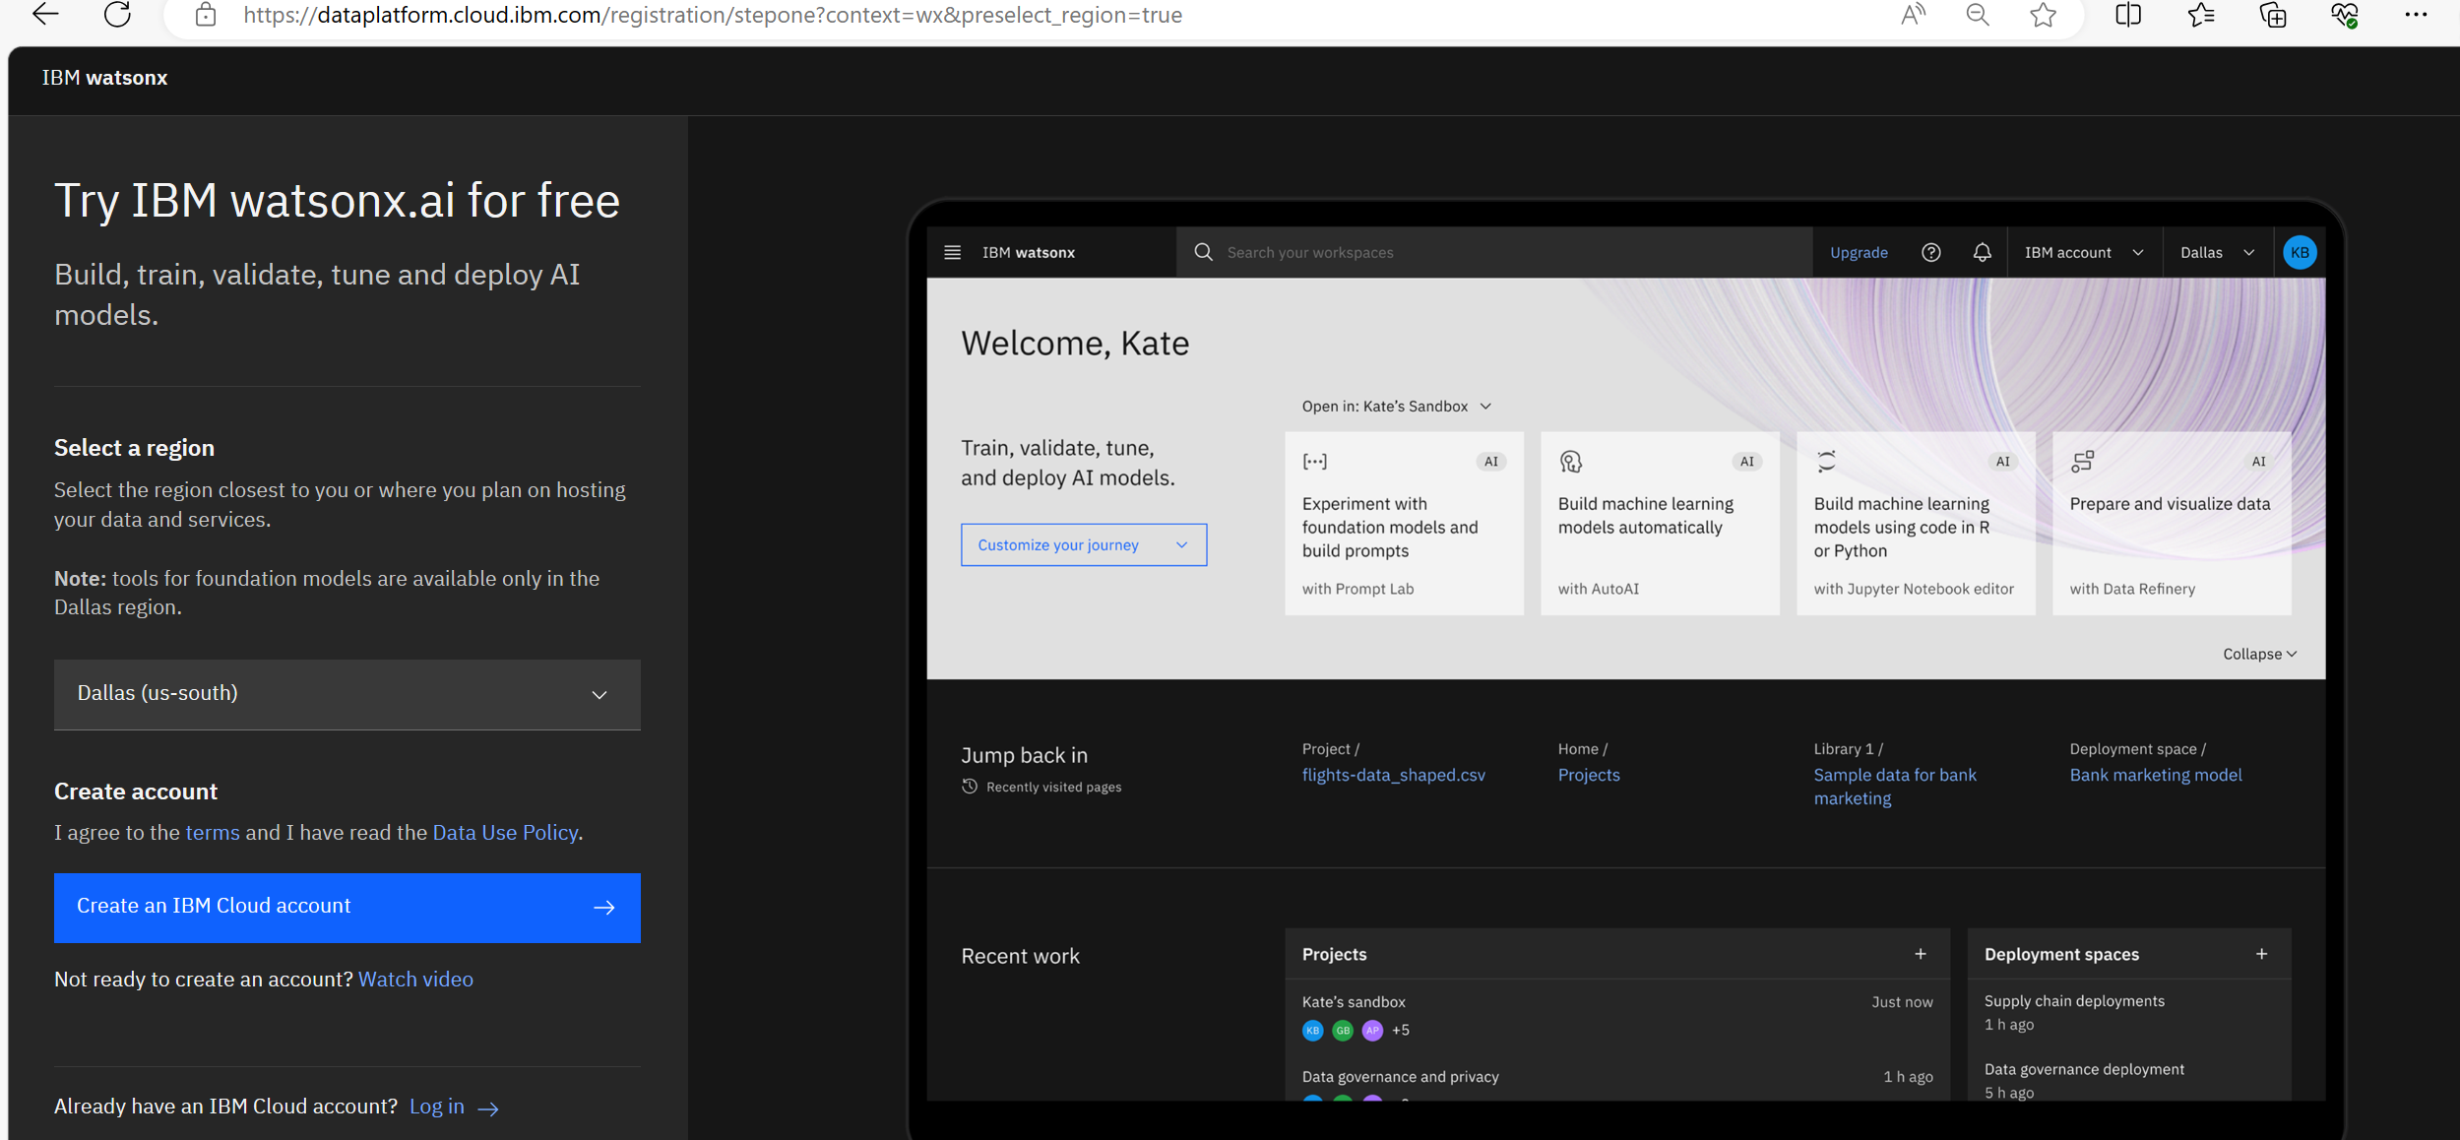
You can try Watsonx.ai out for free…

Slide 10
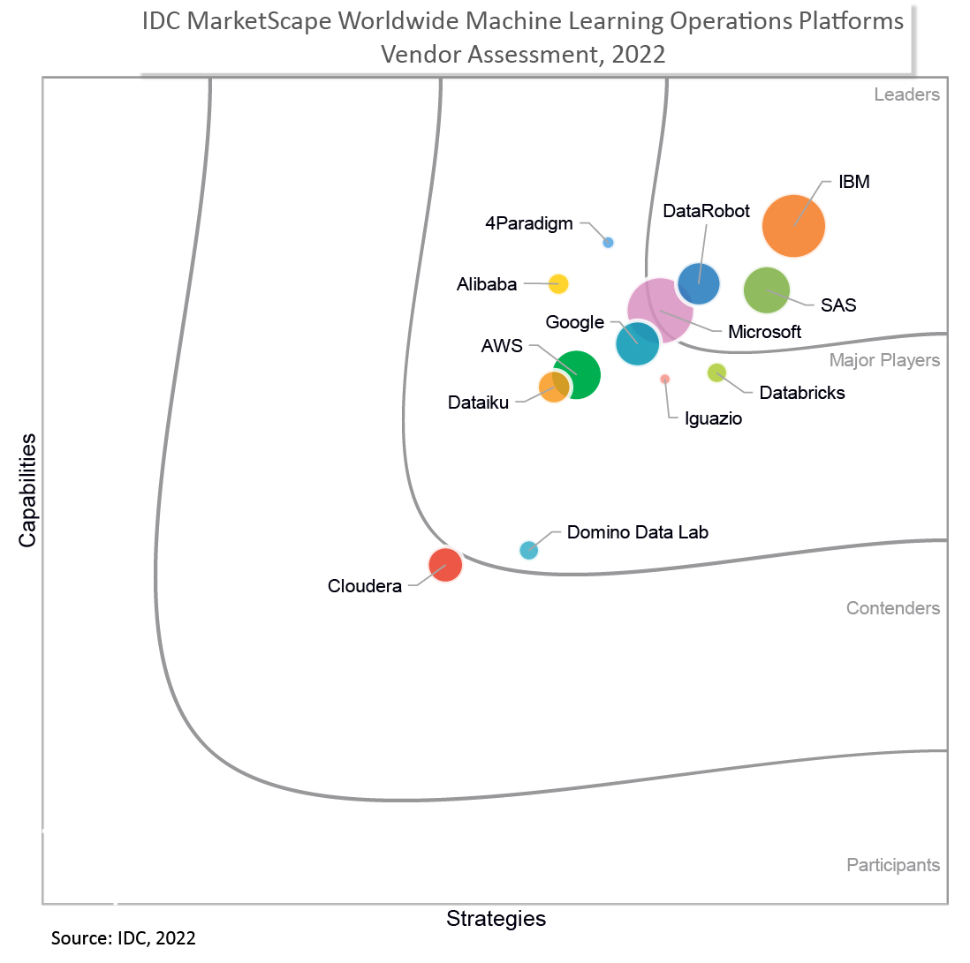
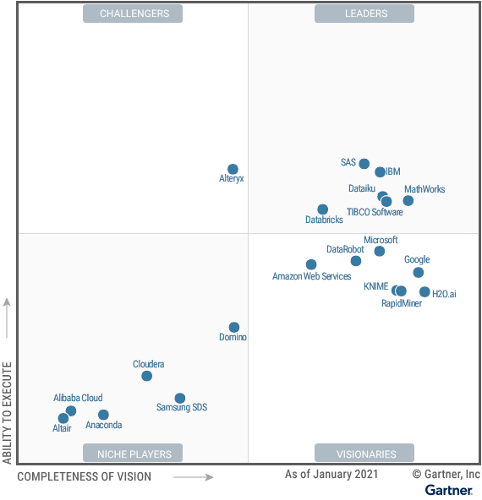
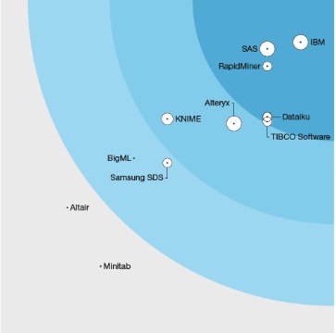
IBM is regarded as a leader in the AI and MLOps market
IDC Marketscape:
Leader in Worldwide Machine Learning Operations Platforms 2022 Vendor Assessment
Gartner Magic
Quadrant for Data Science and Machine Learning Platforms
Forrester Wave:
Multimodal Predictive Analytics and Machine Learning
Notes:
Forrester Wave 2023: Data Management For Analytics - https://www.ibm.com/blog/ibm-named-a-leader-in-the-forrester-wave-data-management-for-analytics-q1-2023/
Gartner MQ Cloud Database Management System - https://www.ibm.com/blogs/journey-to-ai/2021/12/ibm-is-named-a-leader-in-the-2021-gartner-magic-quadrant-for-cloud-database-management-systems-dbms/
Forrester TEI for IBM Data Management - https://www.ibm.com/downloads/cas/9X4AX5WK

Slide 11
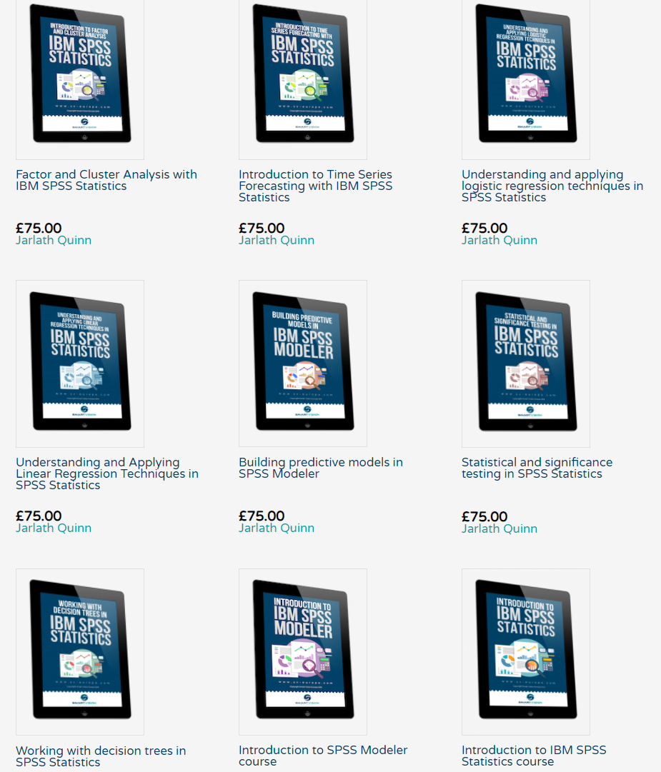
Online training materials free to Smart Vision customers or available for purchase

Slide 12
Working with Smart Vision Europe
Consulting Services
Project Support
Purchase 1-2 days of consultancy time to have an expert work alongside you on your own project
Analytics Advice
Give us 3-5 days to investigate your data & analytical strategy and we’ll present our recommendations re: improvements & alternatives
Analytical Deep-Dive
Let us explore your data landscape to test hypotheses, identify problem areas, find key outcome drivers or develop new applications

Slide 13
Working with Smart Vision Europe
Sourcing Software
  You can buy your analytical software from us often with discounts
  Assist with selection, pilot, implementation & support of analytical tools
  http://www.sv-europe.com/buy-spss-online/
Training
  Formal classroom/virtual training
  Custom course development
  Informal ‘bite-size’ training split over time
Advice and Support
  ‘No strings attached’ technical and business advice relating to analytics
  Tracked technical support services around the IBM SPSS product line

Slide 14
Contact us:
+44 (0)207 786 3568
info@sv-europe.com
Twitter: @sveurope
Follow us on Linked In
Sign up for our Newsletter
Thank you

